Slide 1
DATA SCIENCE, MACHINE LEARNING & AI

Slide 2
DATA SCIENCE

Slide 3
What is Data Science ?
Also known as “Data Driven Science” that makes use of different scientific methods, processes, algorithms and systems to extract knowledge or insights with its goal to discover hidden patterns from the raw data.
In other words, it is about finding and exploring data in the real world and then using that knowledge to solve business problems.
Data Science is applied by the Data Scientist whose primary role is to design and create processes for the complex as well as large scale datasets.
He is involved in processing, cleaning, verifying all the integrities of the data for the analysis. He also build predictive models using Machine Learning Algorithms.

Slide 4


Example !
Customer Prediction
System can be trained based on
customer behaviour pattern to
predict the likelihood of customer
buying a product.
Service Planning
Restaurants can predict how
many customers will visit on a
weekend and plan their food
inventory to handle the demand.

Slide 5
Data Life Cycle
Discovery
Communicate Results
Data Preparation
ONE STOP SOLUTION OF ALL THESE OPERATIONS
Operationalize
Model Planning
DATA SCIENTIST
Model Building

Slide 6



Data Manipulation
It helps us to extract, filter, and transform our data quickly and efficiently.
NumPy
Pandas

Slide 7

NumPy
A python package that stands for "Numerical Python“.
It is used for scientific computing which contains an array object.
Installation – “conda install numpy” | “pip install numpy”
“import numpy”

Slide 8

Pandas
A python package which is used for data manipulation and analysis.
Also used for data like Matrix data, tabular data, statistical data
and many kinds of heterogeneous data also.
Installation - "conda install pandas" | "pip install pandas"
"import pandas"

Slide 9
MACHINE LEARNING

Slide 10
What is Machine Learning ?
It is a type of Artificial Intelligence that allows software applications to learn from the data and become more accurate in predicting outcomes without human intervention.
In other words, it allows software apps to learn of its own by following a set of instructions.
The basic Idea behind Machine Learning is to mimic the way as our brain works.

Slide 11
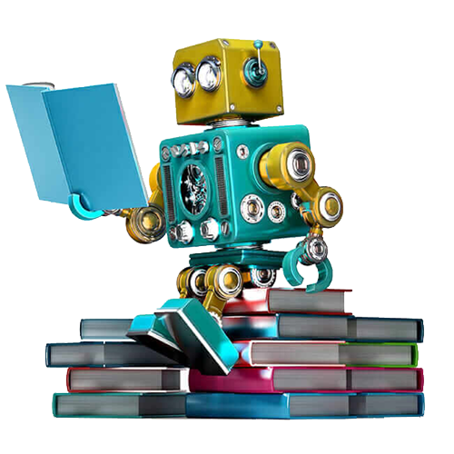
Machine Learning - Flow
Training Data
Learn Algorithm
Build Model
Perform
Feedback

Slide 12
Machine Learning - Types
1
SUPERVISED LEARNING
2
UNSUPERVISED LEARNING
3
REINFORCEMENT LEARNING

Slide 13
SUPERVISED LEARNING
It is where we have a input variable(X) and output variable(Y) and we use an algorithm to learn the mapping function from the input to the output.
Y = f(X)
LINEAR REGRESSION
LOGISTIC REGRESSION
DESCISION TREE
NAIVE BAYES CLASSIFIER
RANDOM FOREST
KNN

Slide 14
SUPERVISED LEARNING - ALGORITHMS
LINEAR REGRESSION
It is used to estimate real values like cost of house, salary prediction, number of sales in a company etc.
LOGISTIC REGRESSION
Used for estimating discrete values i.e. binary values 0 or 1, Yes/No, True/False like spam detection, whether a person can buy certain product or not etc.

Slide 15
SUPERVISED LEARNING - ALGORITHMS
DECISION TREE
Basically used for classification problems, when we want to classify data into different categories. Example - Review greater than 4 is excellent, less than 2 is worst.
RANDOM FOREST
Quite similar to Decision tree but its accuracy is high

Slide 16
SUPERVISED LEARNING - ALGORITHMS
NAIVE BAYES CLASSIFIER
Based on Bayes Theorem where we have no relation between b/w different predictors.
Example - Probability of playing golf at different weather conditions.
KNN (K-NEAREST NEIGHBORS)
An object is classified by a majority vote of its neighbours, or case based on a similarity measure.
Example – Search Results

Slide 17
UNSUPERVISED LEARNING
It is the training of a model using information that is neither classified not labelled in which there is no explanation of the data.
It is also called "Clustering Analysis"
Example - Unlabelled picture or audio downloaded from internet

Slide 18
REINFORCEMENT LEARNING
It is an area of machine learning where an RL agent learns from the consequences of its actions, rather than being taught explicitly.
It selects the actions on the basis of its past experiences(exploitation) and also by new choices (exploration).
Here machine takes the decision on its own.

Slide 19
Applications
Virtual Assistant
Chat Bots
CUSTOMER PRODUCT SUPPORT, RECOMMENDATION, ADVERTISING
Image Recognition
FACE RECOGNITION
eCommerce
Machine Learning
DRUG DISCOVERY,
DISEASE DIAGNOSIS
Social Media
Healthcare
Financial Services
SENTIMENT ANALYSIS, SPAM FILTRATION
ALGORITHMIC TRADING, FRAUD DETECTION

Slide 20
ARTIFICIAL INTELLIGENCE

Slide 21
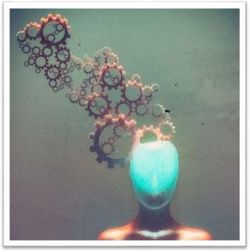
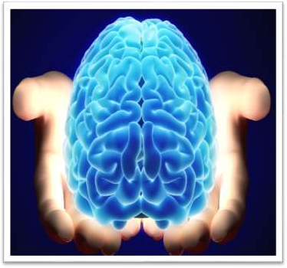
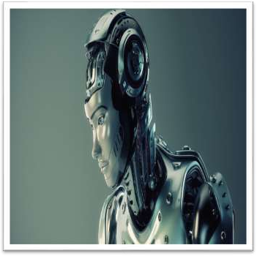

ARTIFICIAL INTELLIGENCE
ARTIFICIAL
INTELLIGENCE
Intelligence: “The capacity to learn and solve problems”
Artificial Intelligence: Artificial intelligence (AI) is the simulation of human intelligence by machines.
The ability to solve problems
The ability to act rationally
The ability to act like humans

Slide 22
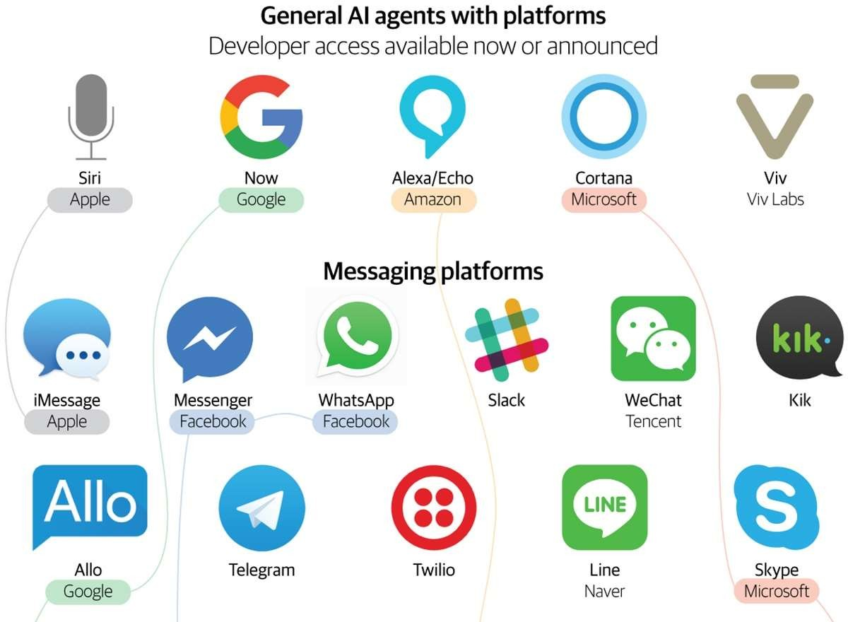

Slide 23


